Slide 1


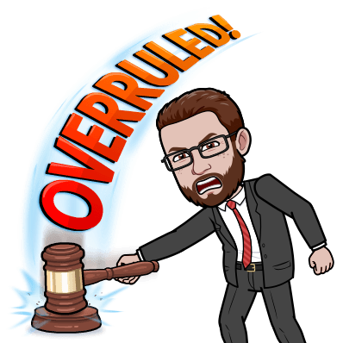
Trial Procedures

Slide 2
The Case of the Stolen Car
The verdict…
GUILTY – 11 votes
NOT GUILTY – 4 votes

Slide 3
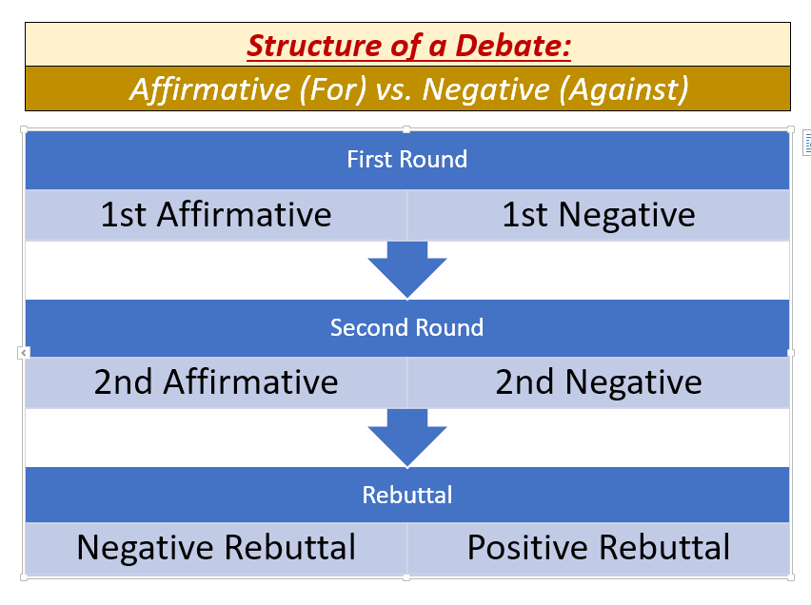
Steps of a Debate

Slide 4
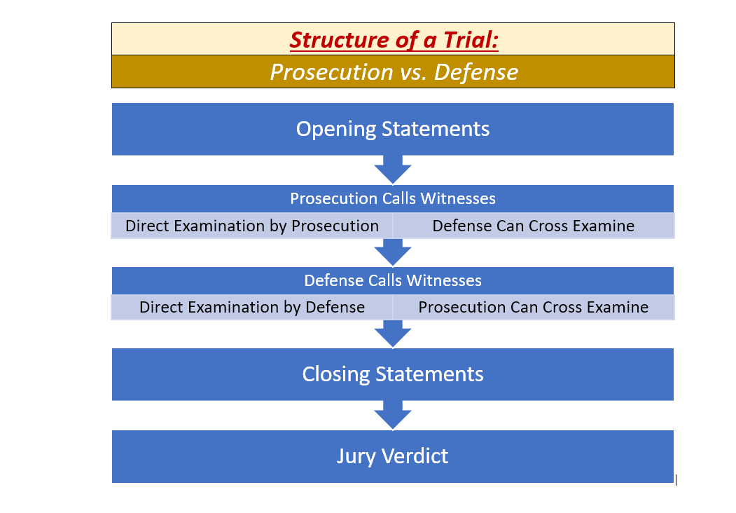
Structure of a Trial

Slide 5
TODAY’S ASSIGNMENT
Find your name on the Mock Trial Teams list.
Go to the post on our main Teams page with your case.
Open the PDF with your case and begin reading the witness statements.
In your breakout rooms:
Discuss with your team who wants to play each role.
Start to go through the witness statements and classify/categorize the facts. Work together on this (you may divide up the work).

